Slide 1
Introduction to Artificial Intelligence and Machine Learning (AI/ML)

Slide 2
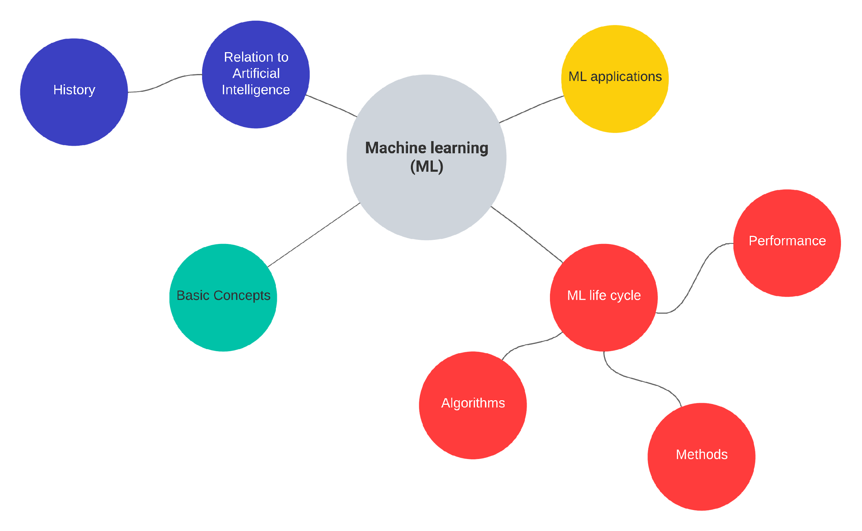

Slide 3
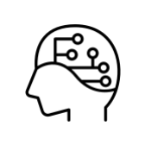
What is Artificial Intelligence (AI)?
“The science and engineering of making intelligent machines, especially intelligent computer programs”. John McCarthy (one of the founders of AI discipline)
The goal of AI has been to create systems that can understand, think, learn, and behave like humans.

Slide 4
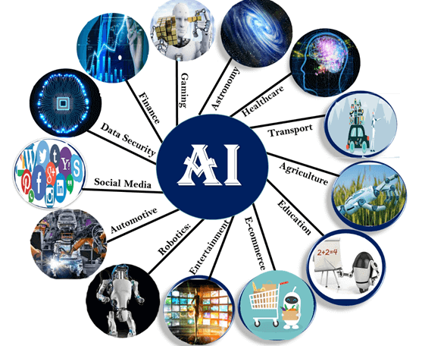
Artificial Intelligence (AI) is applied in a variety of sectors
Agriculture: agriculture robotics, soil and crop monitoring, predictive analysis.
Healthcare: AI can assist doctors to make better and faster diagnosis.
Biomedical: Can assist in prediction (e.g., protein structure), categorization (e.g., pathogenic vs. non-pathogenic variant), summarization of data, etc
Biomedical
Source: https://www.javatpoint.com/application-of-ai

Slide 5
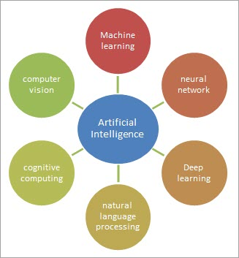
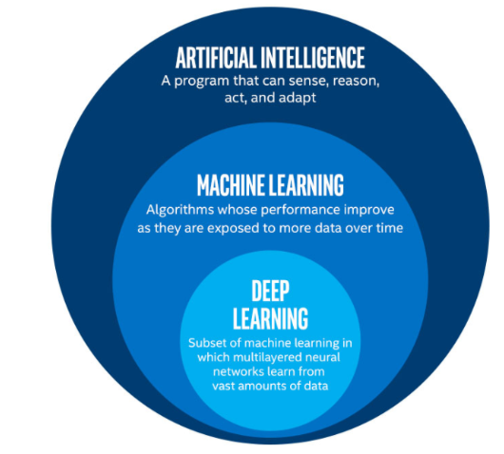
Artificial intelligence is a broad field
Source: https://www.softwaretestinghelp.com/what-is-artificial-intelligence/
(source: Oppermann, 2019)

Slide 6
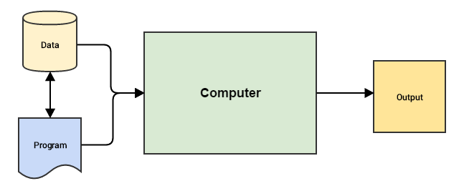
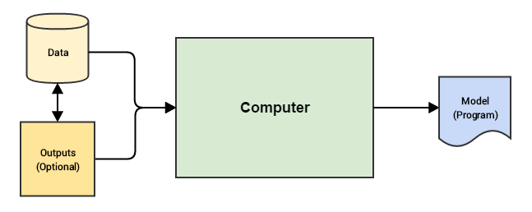
Machine Learning is a Data Driven Approach
Leverages data to get actionable insights and make better decisions
Traditional Paradigm
Machine Learning Paradigm
Programs (logics, rules, codes) enable computers to work on data, perform computations, and generate output
Input data and expected outputs are used to train computer to learn inherent patterns, creating a model that can help predict output for new input data
(source: Sarkar et al. 2018)

Slide 7
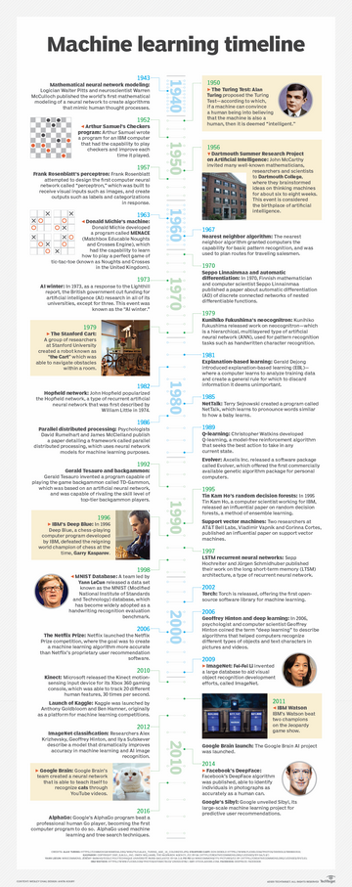
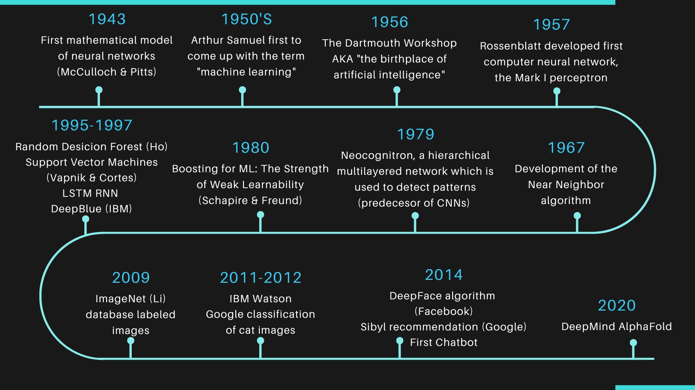
A Snapshot of History of AI/ML/DL
Source: https://www.techtarget.com/whatis/A-Timeline-of-Machine-Learning-History
A more complete timeline: https://labelyourdata.com/articles/history-of-machine-learning-how-did-it-all-start

Slide 8
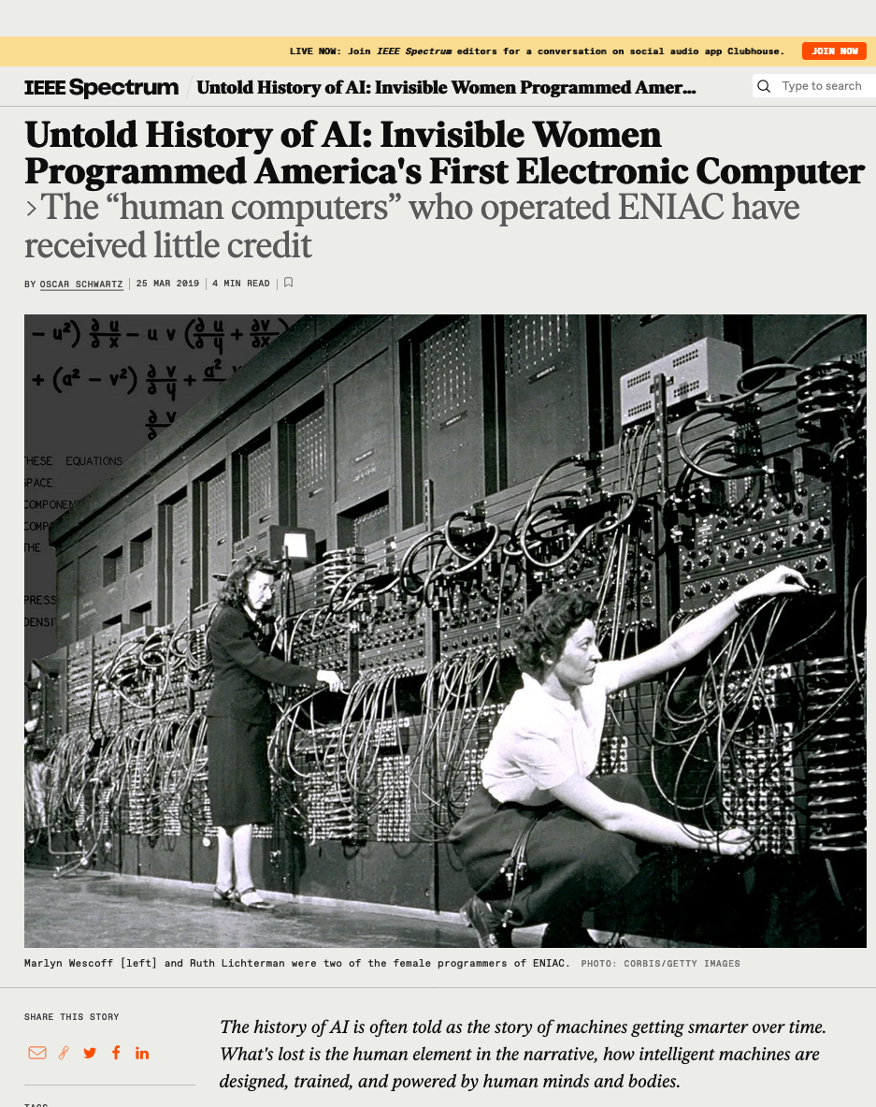
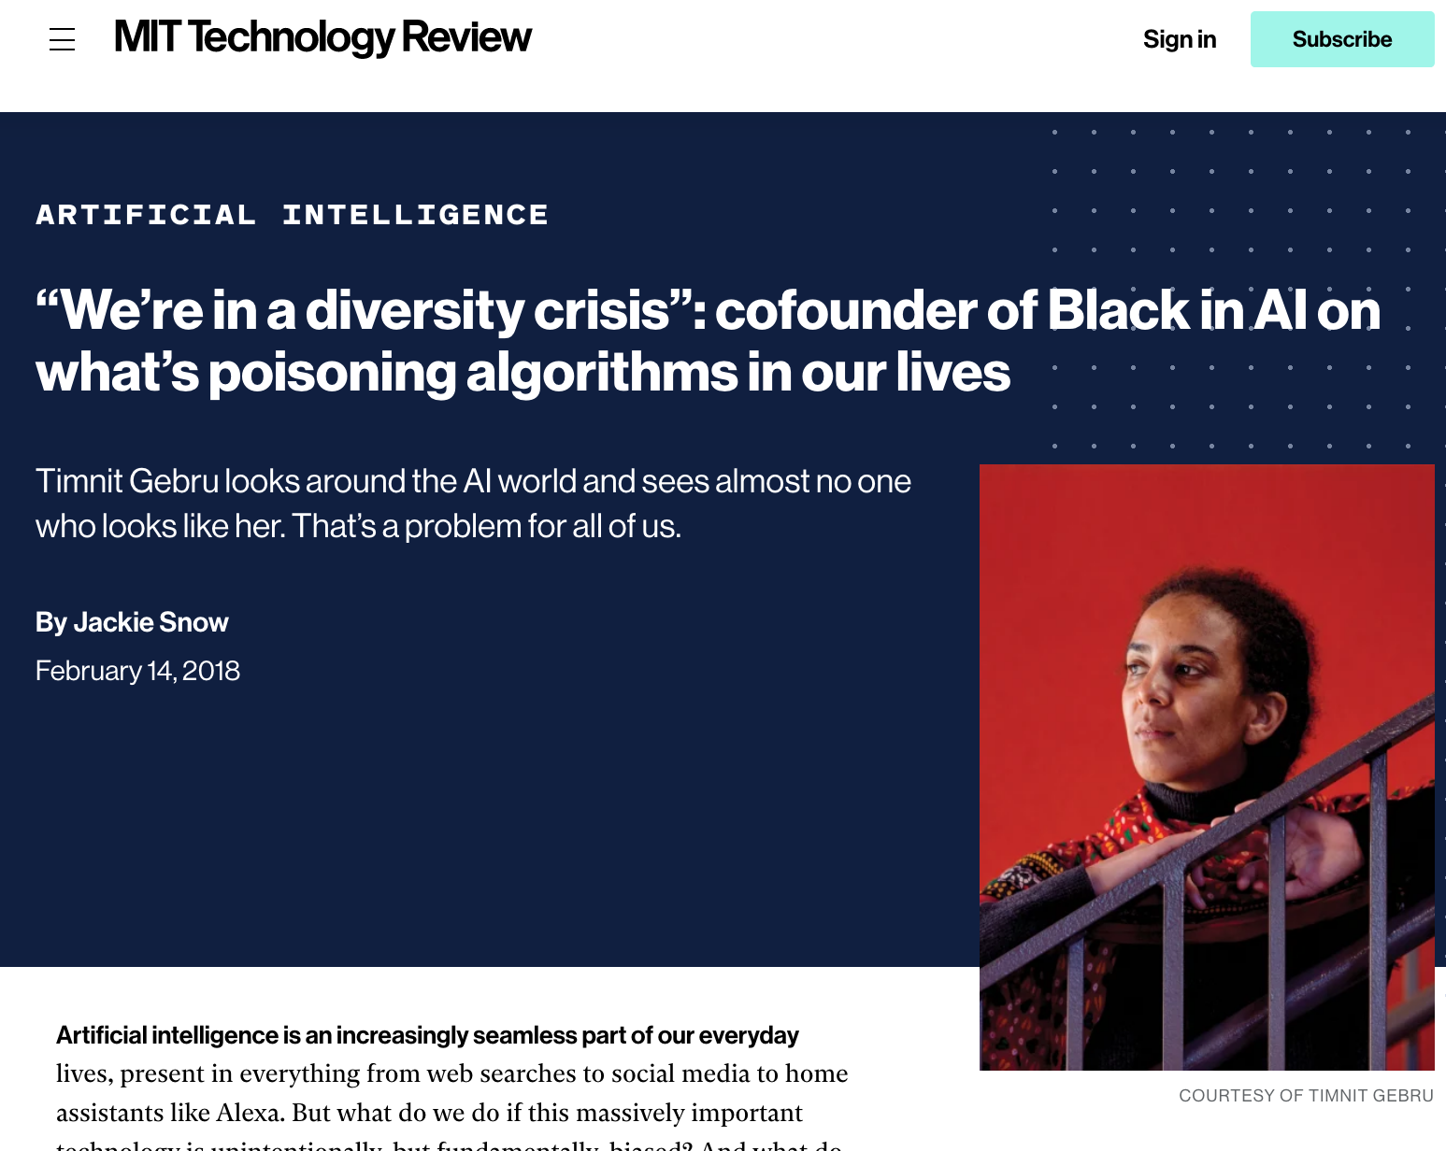
Examining the Timeline Through a DEI Lens
Contributions ignored
Check the photos of the different researchers in this timeline:
https://labelyourdata.com/articles/history-of-machine-learning-how-did-it-all-start
Does anything strike you?
No representation
Source:https://www.technologyreview.com/2018/02/14/145462/were-in-a-diversity-crisis-black-in-ais-founder-on-whats-poisoning-the-algorithms-in-our/
Source: https://spectrum.ieee.org/untold-history-of-ai-invisible-woman-programmed-americas-first-electronic-computer

Slide 9
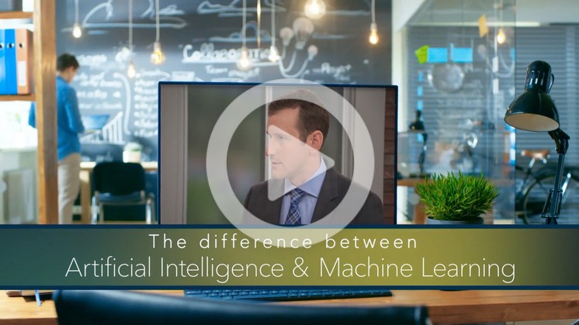
Difference between Artificial Intelligence and Machine Learning
While artificial intelligence (AI) is the broad science of mimicking human abilities, machine learning is a specific subset of AI that trains a machine how to learn
Source: https://www.sas.com/en_us/insights/analytics/machine-learning.html

Slide 11
What is Machine Learning?
“A computer program is said to learn from experience E with respect to some class of tasks
T and performance measure P, if its performance at tasks in T, as measured by P, improves
with experience E.” - Professor Tom Mitchell (1997)
The Task, T
The Experience, E
The Performance, P
Exact problem to solve
Classification or categorization
Regression
Anomaly detection
Translation
Clustering or grouping
Transcriptions
Learning algorithm or model learns inherent pattern from data
Supervised learning
Unsupervised learning
Semi-supervised learning
Reinforcement learning
A quantitative measure or metric used to see how well the model is performing the task T with experience E
Accuracy
Precision
Recall
F1 score
Error/Misclassification rate

Slide 12
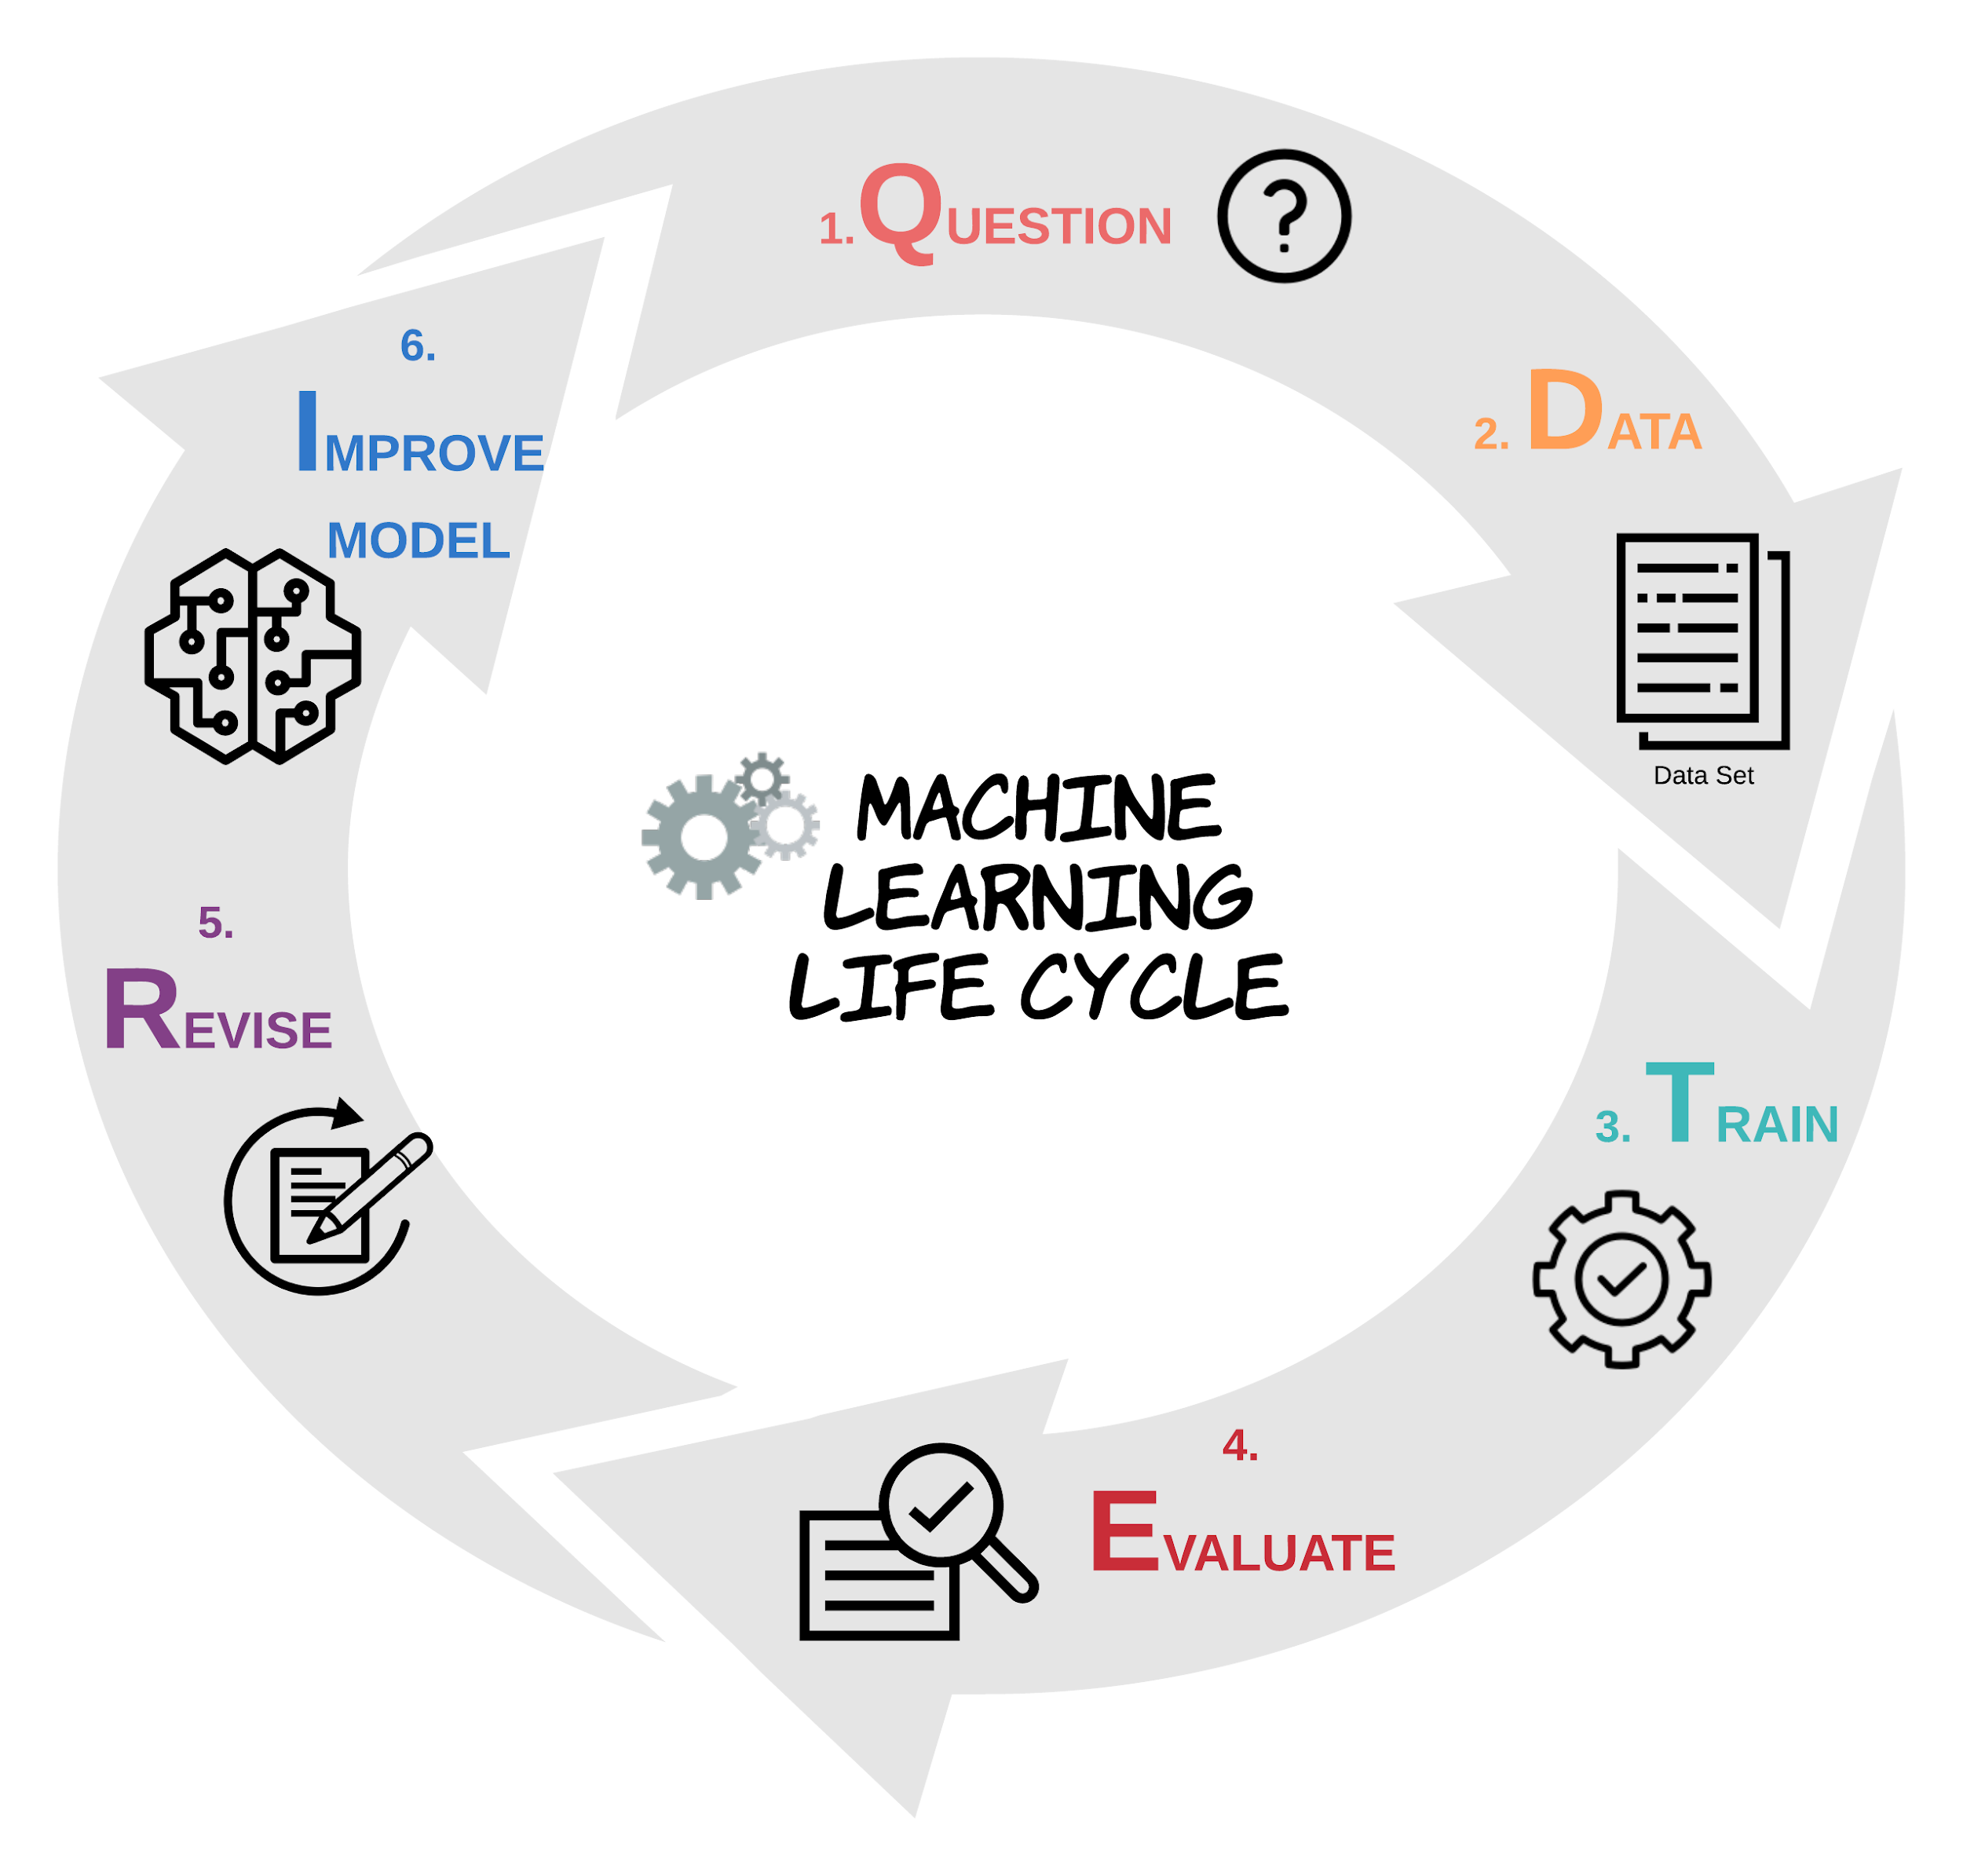
Task
Experience
Performance

Slide 13
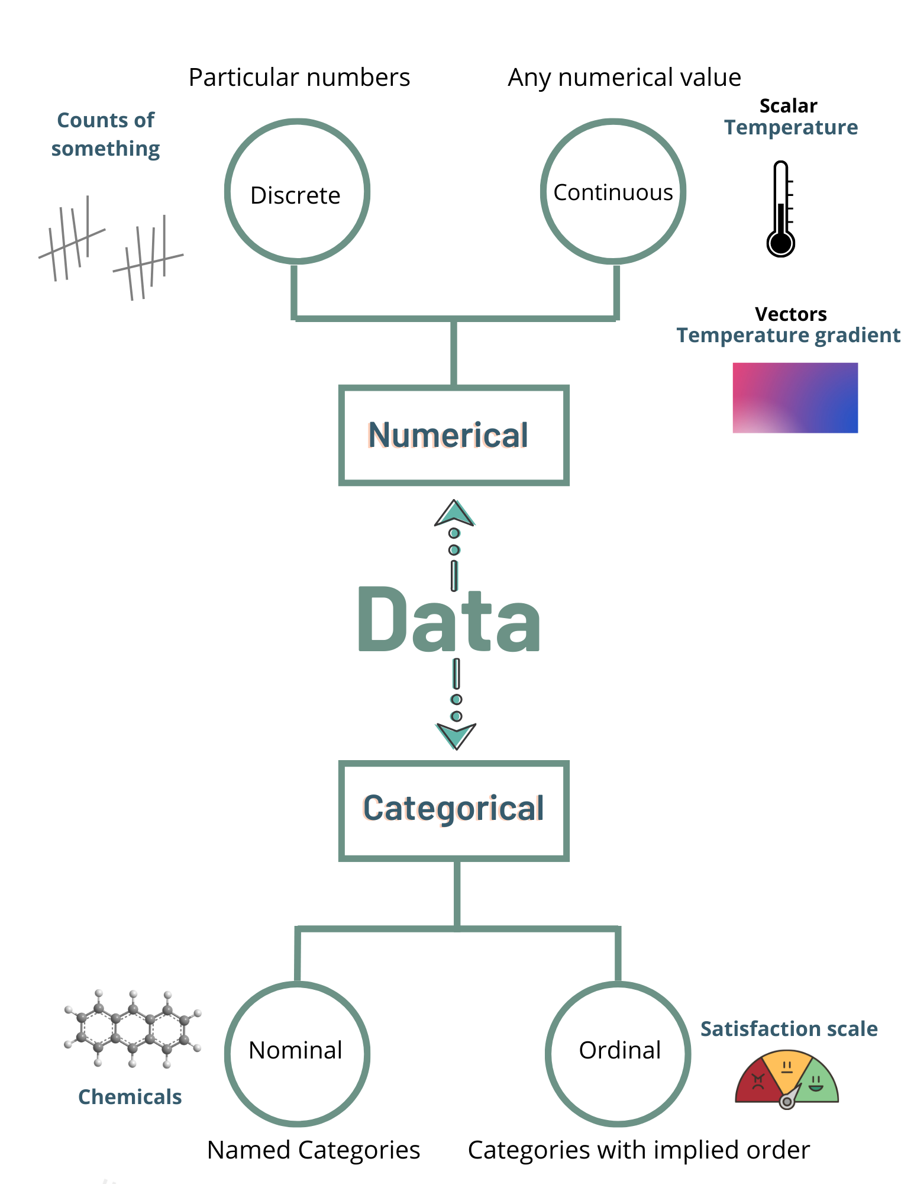
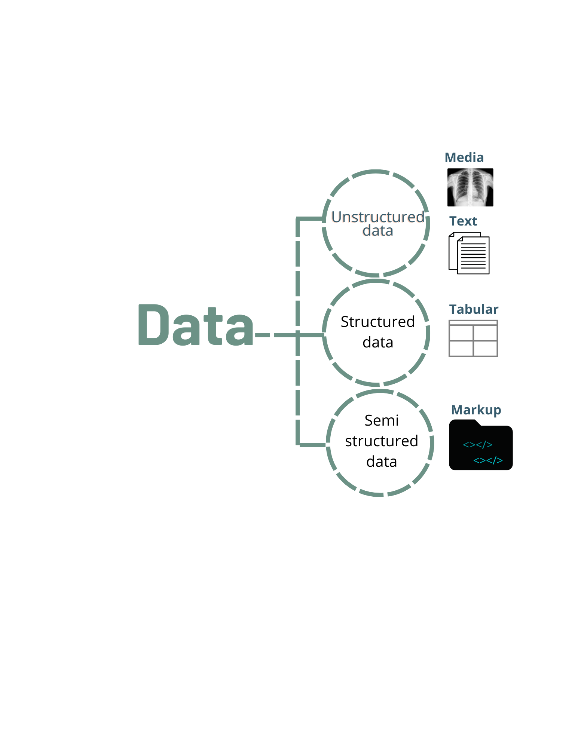
Data Literacy
Algorithms
Important to know data types to correctly apply methods to the data

Slide 14
Algorithms
Now, what data types are the following examples?
Ethnicity
Numerical
Categorical
Place in a competition
Molecular mass
RNAseq read count
Names of bioentities
Discrete
Nominal
Distance
Number of CPUs
Course satisfaction scale
Continuous
Ordinal

Slide 15
Algorithms
What is a model?
A relationship between output or response variables and its corresponding input or independent variables in a dataset
A “model” in machine learning is the output of a machine learning algorithm run on data.
A model represents what was learned by a machine learning algorithm.
Characteristics of ML algorithms:
The model is the “thing” that is saved after running a ML algorithm on training data and represents the rules, numbers, and any other algorithm-specific data structures required to make predictions
Can be described using math and pseudocode
The efficiency of ML algorithms can be analyzed and described
Can be implemented with any one of a range of modern programming languages
E.g. linear regression
The linear regression algorithm results in a model comprised of a vector of coefficients with specific values.

Slide 16
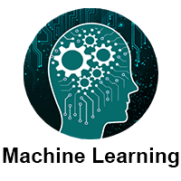
Machine Learning Methods
The Experience, E
The amount of human supervision involvement
The ability to learn from incremental data
The approach to generalization from data
Supervised learning
Unsupervised learning
Semi-supervised learning
Reinforcement learning
Batch (offline) learning
Online learning
Instance based learning
Model based learning
(source: javatpoint.com)

Slide 17
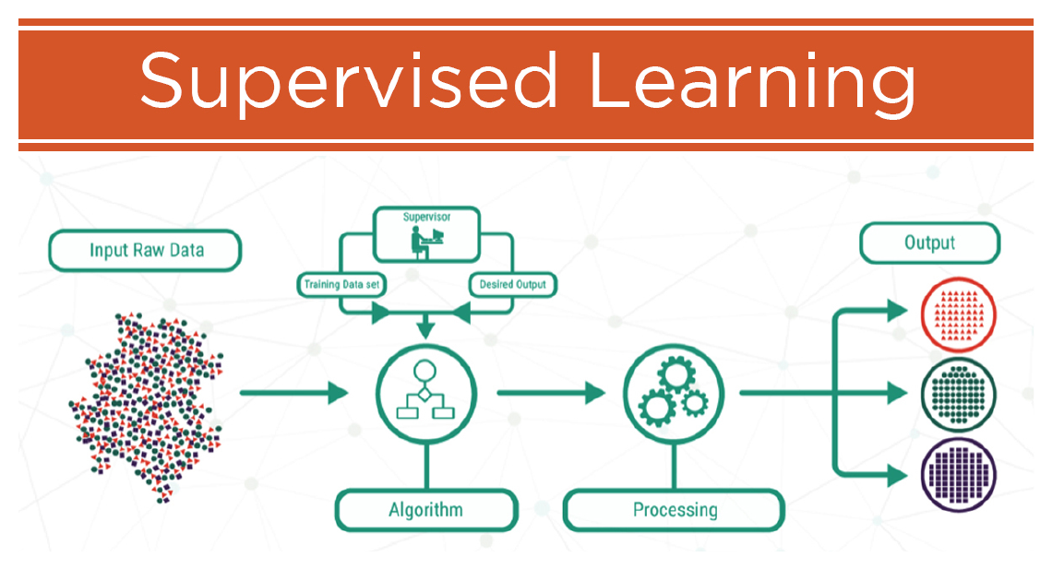
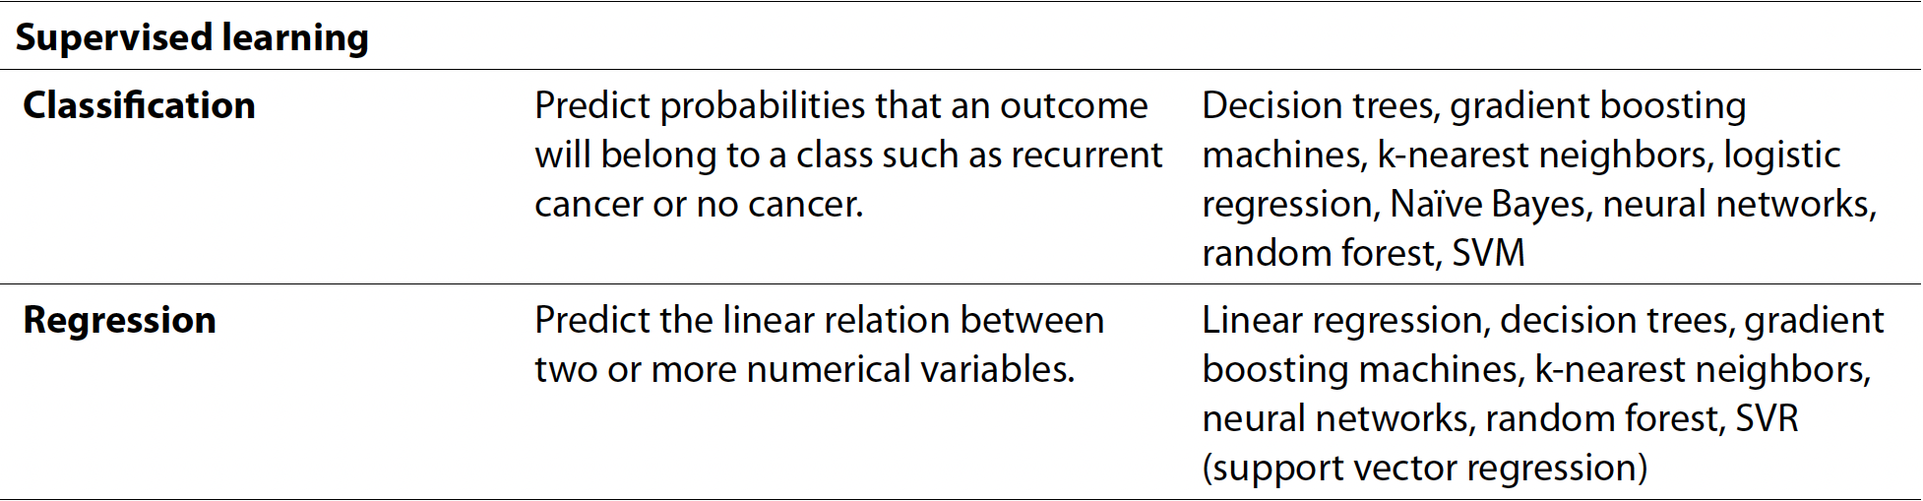
Supervised Learning
E
The amount of human supervision involvement
To model the relationship between the inputs and their corresponding outputs from the training data, as labeled by humans, to predict output responses for new data inputs
Source: Lucidchart
Example
Algorithms
For categorical data
For numerical continuous data
Source: Hoyt & Muenchen. Machine Learning. Chapter 9, Introduction to Data Science

Slide 18
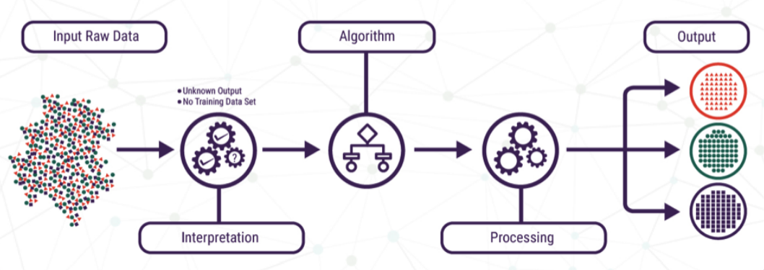
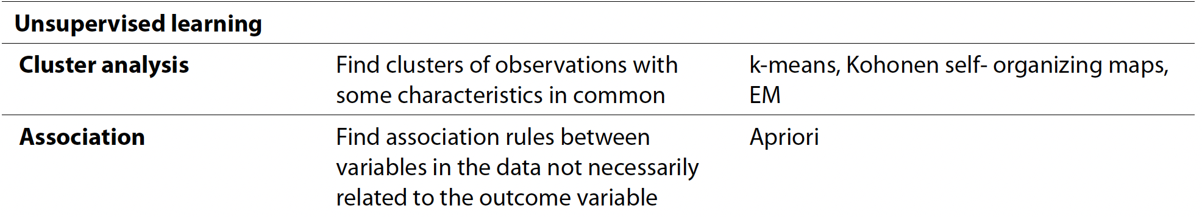
Unsupervised Learning
E
The amount of human supervision involvement
The amount of human supervision involvement
To learn inherent latent structures, patterns and relationships from given data without any help or supervision (No labeled data)
Source: Lucidchart
Example
Algorithms
Source: Hoyt & Muenchen. Machine Learning. Chapter 9, Introduction to Data Science

Slide 19
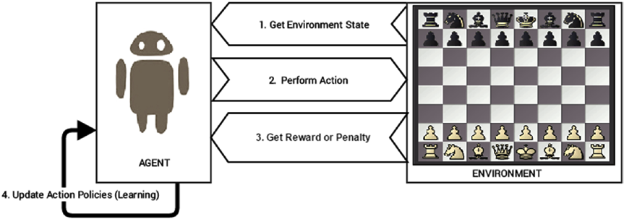
Reinforcement Learning
E
The amount of human supervision involvement
The amount of human supervision involvement
Feedback-based learning method. An agent is trained with reward-penalty over some action, learns automatically with these feedbacks and improves its performance.
Steps:
Prepare agent with set of initial policies and strategy. Observe environment and current state
Select optimal policy and perform action
Get corresponding reward (or penalty)
Update policies if needed
Repeat Steps 1-4 iteratively until agent learns the most optimal policies
(source:Sarkar et al. 2018)

Slide 20
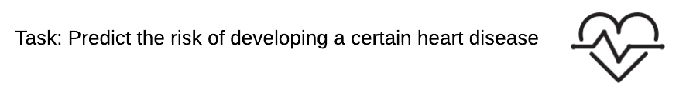
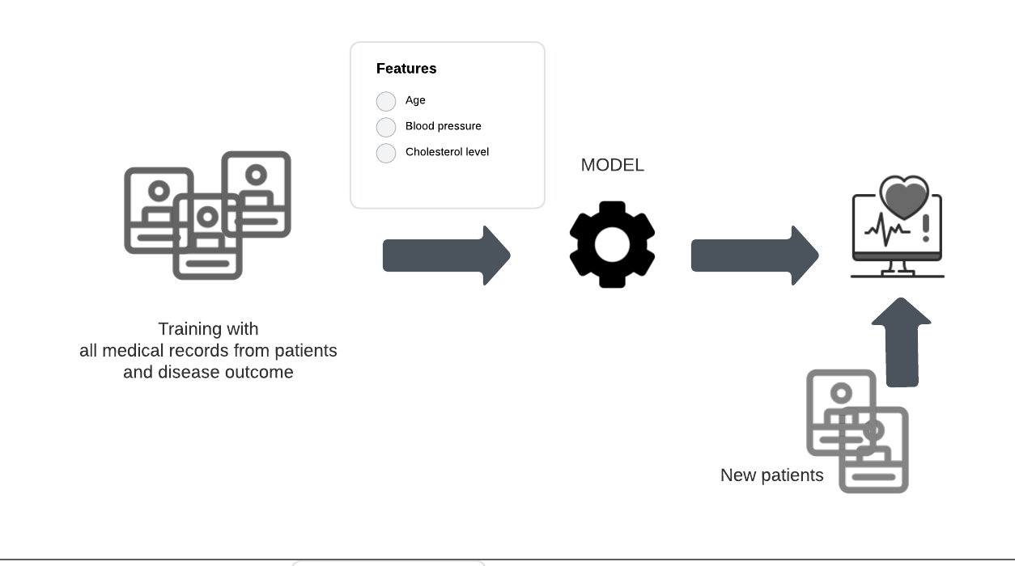
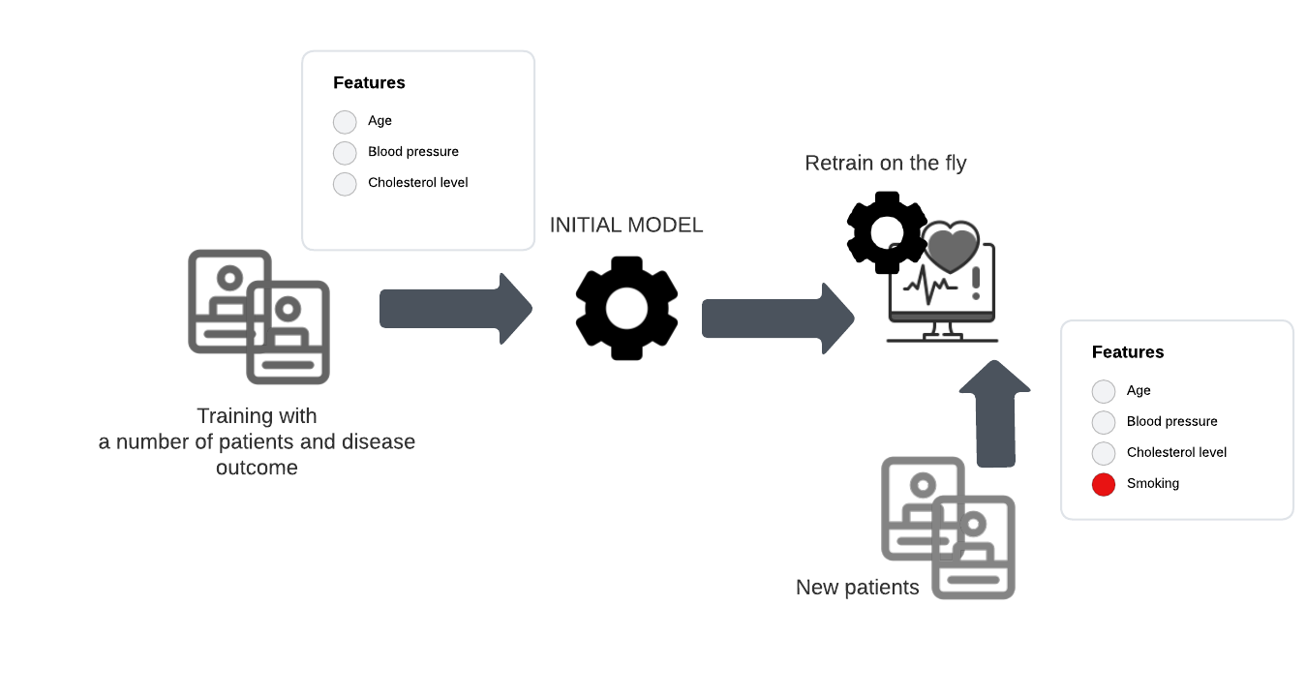
Batch (Offline) vs. Online Learning
E
The ability to learn from incremental data
BATCH (Offline)
ONLINE
Model trained on a fixed dataset and then deployed
Recommended if data distribution does not change frequently
Continuously adapting and learning with new data
Recommended if data distribution changes frequently, as is true in many real-life applications

Slide 21
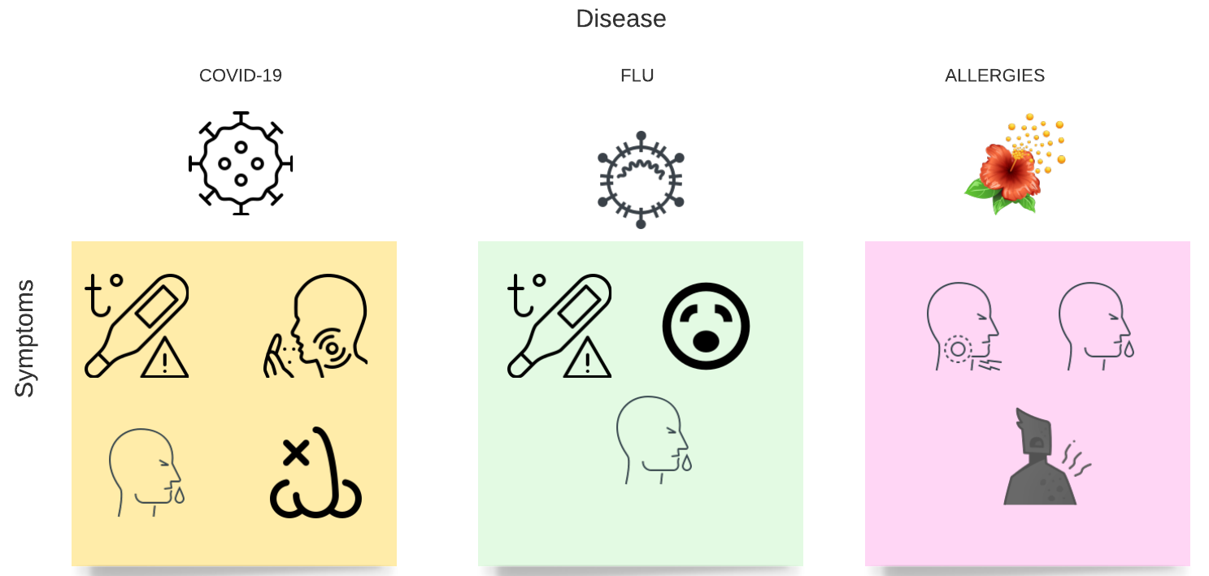


Instance-based learning
E
The approach to generalization from data
BASED ON PREVIOUS OBSERVATIONS/EXAMPLES

Slide 22
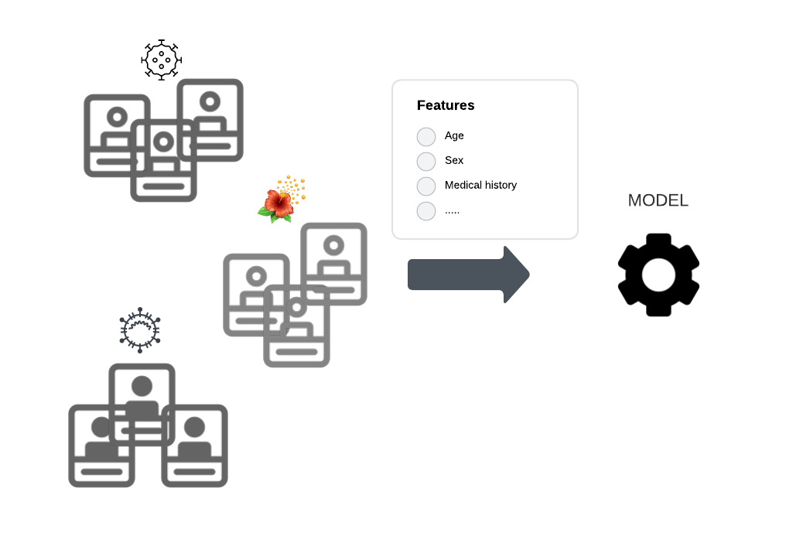

Model-based learning
E
The approach to generalization from data
Prediction
BASED ON PREDICTIONS FROM MODEL

Slide 23
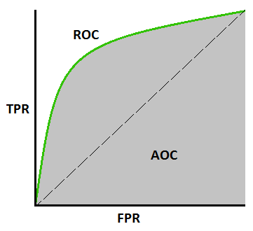
Performance
P
Depending on the algorithm selected: For classification
Confusion Matrix
Actual
 | Positive | Negative
Positive | TP | FP
Negative | FN | TN
Measure | Formula
Accuracy | TP+TN Total
Error rate | FP+FN Total
Recall (aka true positive rate, sensitivity) | TP FN+FP
Precision | TP TP+FP
F-1 measure | 2 x Precision x Recall Precision + Recall
False positive rate | FP TN+FP
Predicted
1
AUC
0
1

Slide 24
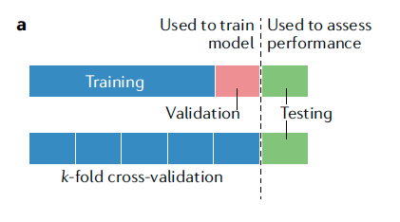
Training, Validation and Testing
Training:
models often require training dataset, which involves automatically adjusting the parameters of a model to improve its performance.
Validation:
Validation dataset is used to monitor but not influence the training process so as to detect potential overfitting.
Testing:
Once a model is trained, it can be tested on data not used for training (hold-out set).
Cross validation:
Dataset for training the model is split into k evenly sized partitions (for example, five or ten) to form k different training and validation sets, and the performance is compared across each partition to select the best hyperparameters.
(source: Greener et al. 2022)

Slide 25

References
Artem Oppermann. Artificial Intelligence vs. Machine Learning vs. Deep Learning. Oct 29, 2019. (https://towardsdatascience.com/artificial-intelligence-vs-machine-learning-vs-deep-learning-2210ba8cc4ac)
Dipanjan Sarkar, Raghav Bali and Tushar Sharma. 2018. Practical Machine Learning with Python. A Problem-Solver's Guide to Building Real-World Intelligent Systems. Apress. (https://doi.org/10.1007/978-1-4842-3207-1), Chapter 1, 2.
Machine Learning Tutorial. (https://www.javatpoint.com/machine-learning)
Greener, J.G., Kandathil, S.M., Moffat, L. et al. A guide to machine learning for biologists. Nat Rev Mol Cell Biol 23, 40–55 (2022). https://doi.org/10.1038/s41580-021-00407-0
Robert Hoyt and Robert Muenchen, Introduction to biomedical data science, Chapter 9.

